Slide 1
MBTA Network Redesign
Overview of Metrics

Slide 2
Proposed Network Level Goals
The Internal Task Force members developed the following goal statements based on the problem statement:
Equity: Provide competitive service and increase access for vulnerable populations.
Economy: Deliver a high capacity transportation network that provides peak service where needed to support the continued economic development of the metropolitan region.
Environment: Reduce transportation emissions by supporting the ability to live car-free and attracting ridership from cars.
Notes:
Access
Peak Service
Demand, environmental call relates to maximizing ridership
Measure can be constrained as needed for each of the goals: to high-demand times (economy), to set different competitiveness thresholds (equity), etc.

Slide 3
Philosophy for Developing Metrics
Network level metrics are informed by the goals and should:
Focus on the network as a whole or key corridors (not on routes)
Quantify success at matching service with demand
Recognize the role the bus plays within the larger MBTA system
Capture speed and reliability improvements from bus lanes and other priority treatments
Value network simplicity (network follows logical travel patterns)
Value responsible stewardship (i.e. passengers per revenue hour)

Slide 4
Approach to Developing Metrics
In order for bus service to be successful with the Equity, Environment, and Economy goals, the network should consider what makes transit
competitive with other modes:
and what makes it competitive for:
Trip time
Frequency
Cost
Reliability
First/Last Mile Connections; Coverage
Existing Transit Trips…
By everyday riders that use the MBTA to meet some or most of their travel needs
By people from environmental Justice communities
By people with mobility issues
Potential Transit Trips…
By people who do not frequently use the system, but could
By people whose trip-making patterns are not served by MBTA
By riders that previously used the system more than they do today
Notes:
We have been thinking internally about competitiveness as being an overarching way to look at metrics
How and where we can be competitive and what does it mean to provide a competitive option?
Need your help with this in creating network level metrics.
The first phase of the BBP was driven by SDP metrics at route level (OTP, crowding, reliability)
We are looking at network level metrics – how well is network as a whole connecting population to jobs

Slide 5
Approach to Developing Metrics
The Task Force identified the following considerations for competitiveness:
Trip time
Frequency
Cost
Span of service
Reliability
Comfort
Simplicity of Network
Transfers
First/Last Mile Connections; Coverage
Communications
Competitiveness will look different based on origin point (for whom/from where):
Existing customers
Environmental Justice communities
People with mobility issues
Focus40 Priority Places
Transit friendly municipalities
Dense areas
Competitiveness will look different based on destinations (to what/to where):
Existing high-demand destinations
Important destinations from equity perspective
Destinations from each residence
Competitive destination access for different communities/neighborhoods
Notes:
We need to better understand what factors influence the decision to take transit/what makes it a competitive option? – survey research, other ways to understand? (feedback from BBP, OPMI customer survey, other resources?)

Slide 6
What is our universe of Travel?
O-D actual travel data
All purposes
All modes
Expanded to all travel as much as possible, supplemented with additional data where lacking
Paths of travel evaluated with different modes
Paths of travel compared for competitiveness across modes

Slide 7
Trip Planning Tool Evaluation
OPMI has identified two possible tools to help analyze the competitiveness of existing and possible OD pairs within the service area
Google API Suite
Open Trip Planner
Selecting a proper trip planning tool is essential, as it serves as the foundation of the competitiveness analysis
Key features include:
Customizable (should accept hypothetical networks for evaluation)
Automatable
Accurate travel time predictions
Ability to process multi-modal trips (such as park & ride)

Slide 8
Tool Comparison
Feature | Google API | Open Trip Planner (OTP)
Customizable | ✘ | ✓
Automatable | ✓ | ✓
Trip Routing | ✓ | ✓
Robust transit time predictions | ✓ | ✓
Robust driving time predictions | ✓ | ✘
Multi-modal trips | ✘ | ✓
Free | ✘ | ✓
Easy set-up | ✓ | ✘

Slide 9
Trip Planning Tool Evaluation: Conclusion
Travel times
Both OTP and the Google API appear to route trips similarly, but both tools predict different travel times
This gap may be closed by adjusting the ‘costs’ being used by OTP
Tool selection
Due to its customizability, OTP can serve as a good foundation to build up the desired tool, and seems like the best option for transit routing
It might be necessary to supplement this with Google API data for driving times to better capture the impacts of traffic/congestion on the roads

Slide 10
Current Trip Travel Time Competitiveness
1
Why this metric?
Methodology
Outstanding questions

Slide 11
What is this metric and why?
Goals: What is the baseline of competitiveness given current MBTA network and current trip-making patterns?
Will be evaluated under economy, environment, and equity lens for relevant baselines
Definition:
% of all trips being made in the MBTA service area that can be made competitively using MBTA services compared to driving
Purpose:
This measure attempts to capture the MBTA’s ability to meet current demand for trip making in the region
This measure highlights high-demand OD pairs, incentivizing the provision of services in these areas
Measure can be constrained as needed for each of the goals: to high-demand times (economy), to set different competitiveness thresholds (equity), etc.

Slide 12
Methodology: Current Competitiveness
Select desired geography (intersection, block, etc.)
Associate a lat/long with each geography
Run each OD pair through trip planning software to identify travel times during peak, off-peak, and weekend for driving and transit
Select a ‘competitive’ threshold to compare car travel times and transit travel times
Compare total travel time for modes and identify which one is competitive

Slide 13
Methodology: Threshold Example

Slide 14
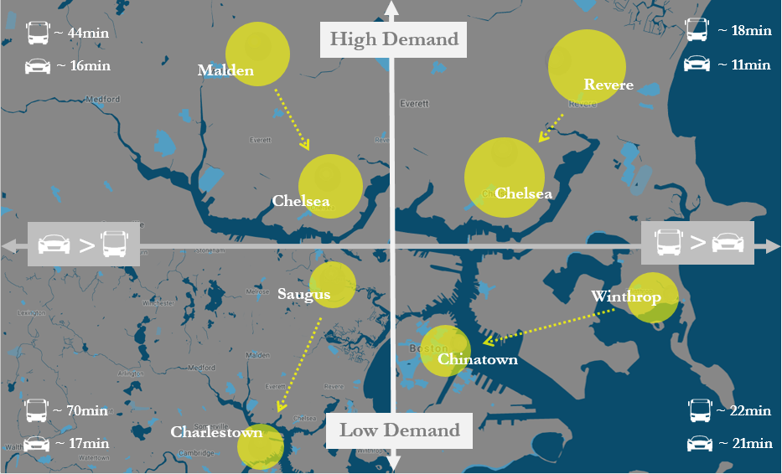
Example
Note: Competitiveness in this graphic is just focused on travel time

Slide 15
Equity Methodology Ideas
While the top level measure highlights high-demand OD pairs for the population as a whole, its equity counterpart should focus on high-demand trips for vulnerable populations
Measure would be place-based due to data constraints; the universe of trips would be narrowed down to places that have high proportions of targeted populations
Each population may have different thresholds about what makes service competitive, e.g. people that use mobility devices may value accessible stops and trips with less walking compared to other populations

Slide 16
Outstanding Questions
How to we capture park & ride trips in a meaningful manner?
How do trip alternatives affect travel time competitiveness? How do we capture “real” trip alternatives?
How do we treat ‘walking’ only trips?
How does this bias the competitiveness of routes for people with high preference towards minimizing walking?
How do we deal with commuter rail?
What is the smallest available geography for the cell phone data?
How do you apply a framework similar to this to the other components of competitiveness?

Slide 17
Competitive Access to High-Demand Destinations
2
Why this metric?
Methodology
Outstanding questions

Slide 18
What is this metric and why?
Goals: Measure to access to relevant destinations (regionally-important economic centers as well as local destinations).
Will be evaluated for different populations of interest
Will be residentially-based rather than trip-based (as in Metric 1)
Definitions:
Regional high-demand destinations:
% of all origins that can access x of y high-demand destinations
Local high-demand destinations:
% of all origins that can access x of y high-demand destinations in a specific, smaller geography (e.g. 3 miles?)
Purpose:
The first measure focuses on trips that are currently happening; this measure ensures that we also capture potential trips that may not be occurring in transit due to the way the system is currently set up (path dependency)
Some destinations should be accessible to everyone in the region due to their economic importance (e.g. downtown, Logan airport, etc)
Some destinations may not be important regionally but may be essential at a local level (e.g. a town square, a local grocery store)

Slide 19
What does Regional Access looks like?
The origin-destination data will be used to identify the region’s most important destinations to maximize competitive access to these areas. These high demand destinations are being categorized into:
Regional Centers – Destinations that are regionally important that the MBTA should provide competitive access in to maximize access by providing peak service (the expanded “regional CBD”)
Subregional Centers – Major commercial districts/squares; shopping centers
Local Centers – Neighborhood scale commercial districts/squares
Notes:
Regional high-demand destinations:
Identify every destination in the LBS dataset, regardless of origin
From these destinations, identify the most in-demand destinations
Use trip planning software from every O in the region to the high-demand Ds and identify which trips are competitive
Local high-demand destinations:
Choose predetermined, familiar geographies (towns, neighborhoods, etc.)
Isolate the OD pairs that take place within that geography
From that geography-specific dataset, identify the most in-demand destinations (removing the regional nodes)
Use trip planning software from every O in the geography to the high-demand Ds and identify which trips are competitive

Slide 20
Methodology
Regional high-demand destinations:
Identify every destination in the LBS dataset, regardless of origin
From these destinations, identify the most in-demand destinations
Use trip planning software from every O in the region to the high-demand Ds and identify which trips are competitive
Sub-regional centers + Local high-demand destinations:
Determine radius threshold
Choose predetermined, familiar geographies (towns, neighborhoods, etc.)
Isolate the OD pairs that take place within that geography
From that geography-specific dataset, identify the most in-demand destinations (removing the regional nodes)
Use trip planning software from every O in the geography to the high-demand Ds and identify which trips are competitive

Slide 21
Regional Travel Locations
Some trip destinations have an extremely high demand regardless of mode
These high-demand locations should be competitively accessible by everyone in the region

Slide 22
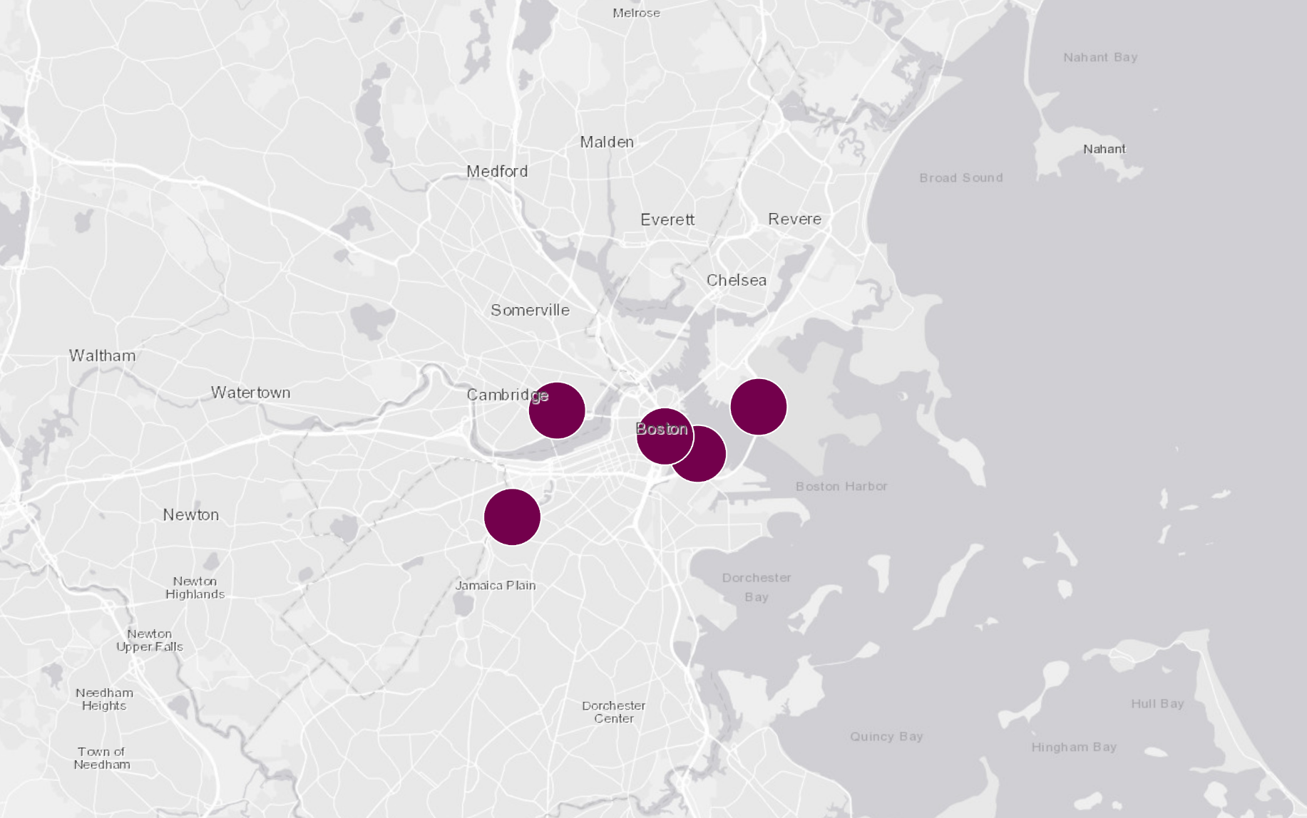
Regional Travel Locations
Once regional locations are identified in the data, they can be mapped
Competitive access to these locations from a geographic unit (such as intersections) can then be tested by using the parameters established in the competitive analysis
Targets can be set to better evaluate access to these locations, e.g.:
“70% of origins in the service area have competitive access to the top 5 most demanded regional locations; the MBTA aims to provide 80% competitive access”
Kendall Square
Financial Dist
Logan Airport
Seaport
Longwood Medical

Slide 23
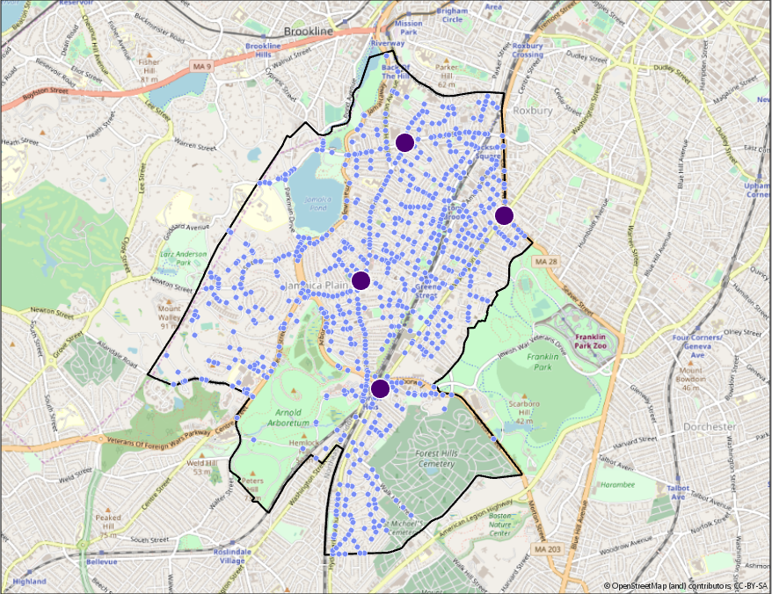
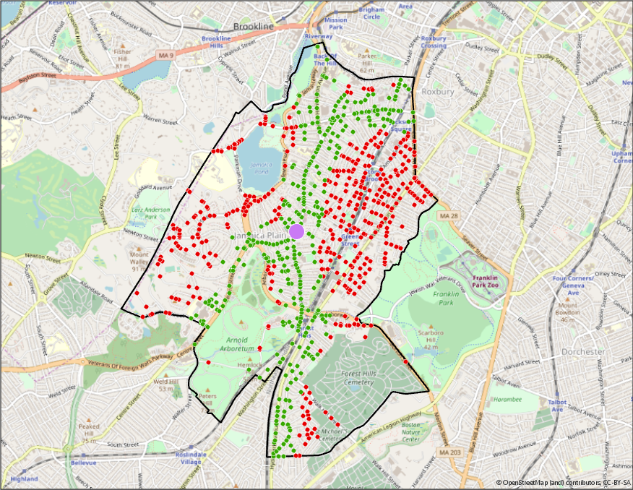
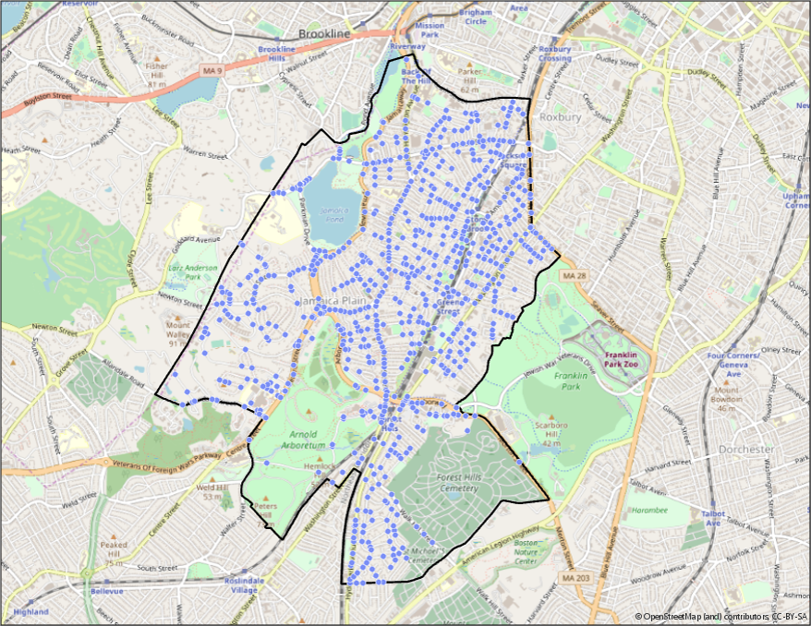
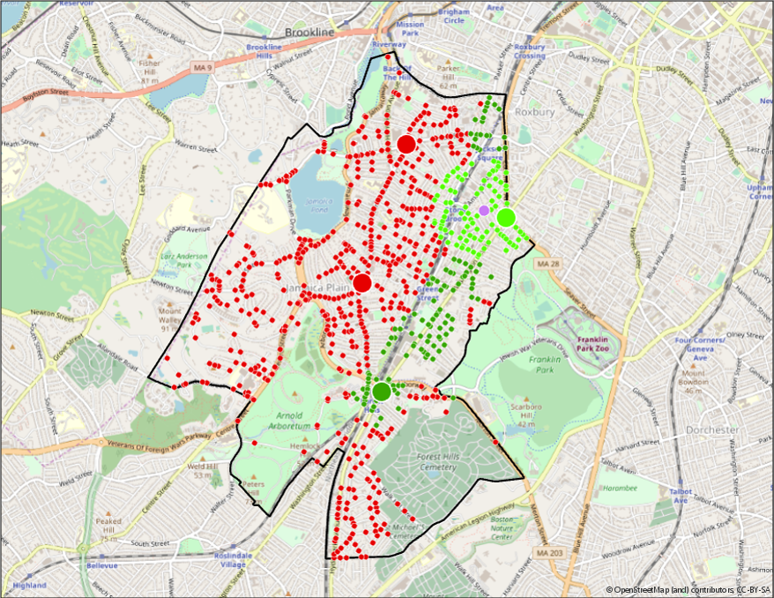
Local Travel Locations
We can identify local travel locations using a mixed approach
Familiar geographic areas (such as neighborhoods or towns) are selected and the top five demanded destinations are mapped
We can evaluate which neighborhood origins have competitive access to each of these locations
Evaluation should also be possible at the origin; that is, all competitively accessible destinations should be identifiable from any origin

Slide 24
Outstanding Questions
What should the geography thresholds be for each group?
What counts as a high-demand destination?
Are there important destinations that may not be “high-demand”?
How do we define a destination geographically?

Slide 25
Carbon Emissions
3
Why this metric?
Methodology
Outstanding questions

Slide 26
What is this metric and why?
Goal: Measure environmental benefits of mode shift from cars to transit as well as environmental benefits for improving transit conditions
Definition:
Comparison of emissions generated for all trip-making – for what percentage of trips are we “competitively” serving in terms of saving emissions?
Purpose:
Service that is fast and high-ridership is the most environmentally friendly – we want to maximize these benefits in service by improving speed (minimizing circuitousness, bus lanes) and making service appealing to riders (improved service quality, located in dense areas and in corridors with high demand)

Slide 27
Methodology
Develop emissions factors for different kinds of buses:
High load, high speed
High load, low speed
Low load, high speed
Low load, low speed
Identify emission factor for driving trips
For each trip in our OD dataset, identify whether transit provides a competitive trip from an emissions standpoint by comparing transit and driving emissions
Transit will always fare better except when no transit option exists OR when transit is very indirect. The metric will reward speed improvements and routes designed for high ridership (that serve high demand OD pairs, are high frequency, etc).

Slide 28
Equity Methodology Ideas
Is the equity component for this about air quality as opposed to carbon emissions, which have more diffuse effects?

Slide 29
Outstanding Questions
For applying this metric to new networks, we would have to assign new routes/corridors to one of the four bus categories. We will need to decide how to do that – based on comparing new routes to current routes, based on route purpose?
Where can we get an updated driving emissions factor for Massachusetts or New England?

Slide 30
Supplemental Data
MBTA Parking Data
RMV ATLAS Data
AFC Data, ODX
Census data (Rider / ACS)
Google Places
OD data for The RIDE
Surveys as needed

